Slide 1
Software Requirements Analysis, Design and Modeling
Chapter 5.2
GRASP: More Objects with Responsibilities
Notes:
这节课，我们一起学习
第 5.2 章节 第 19 个知识域：GRASP:更多具有职责的对象
//下面是备注 不放入脚本
对应课本第 25 章 P300-310

Slide 2
Objectives
Learn to apply the remaining 4 GRASP patterns.
Notes:
本次课的目标是
学习剩余的4个GRASP设计模式

Slide 3
Content Outline
Polymorphism.
Pure Fabrication.
Indirection.
Protected Variations
Notes:
首先介绍
多态
// 后面仅供参考，不放入脚本
下面介绍
纯虚构
下面介绍
间接性
最后介绍
防止变异

Slide 4
Polymorphism
Problem
How handle alternatives based on type?
How to create pluggable software components?
Solution
When related alternatives or behaviors vary by type (class), assign responsibility for the behavior using polymorphic operations to the types for which the behavior varies.
Corollary: Do not test for the type of an object and use conditional logic to perform varying alternatives based on type.
Notes:
1.问题
1.1如何处理基于类型的选择？
1.2如何创建可插拔的软件构件？
2.解决方案
2.1当相关选择或行为随类型（类）有所不同时
使用多态操作为变化的行为类型分配职责
2.2推论：不要测试对象的类型
也不要使用条件逻辑来执行基于类型的不同选择

Slide 5
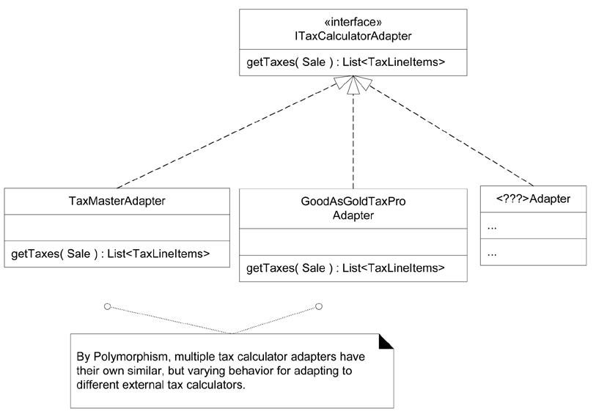
Polymorphism: Example
NextGen Problem: How Support Third-Party Tax Calculators?
Figure 25.1. Polymorphism in adapting to different external tax calculators.
Notes:
多态：例子
NextGen 问题：如何支持第三方税金计算器？
在 NextGen POS 应用中
必须支持多种外部的第三方税金计算器
（例如 Tax-Master 和 Good- As-GoldTaxPro )
系统需要能够集成不同的产品
每个税金计算器具有不同的接口
因此需要有类似但不同的行为 以适配每种外部的固定接口或API
—种产品可能支持原生 TCP socket 协议
另一种可能提供 SOAP 接口
而第三种可能会提供 Java RMI 接口
哪些对象应该负责处理这些不同的外部税金计算器接口呢？
因为计算器适配的行为随计算器类型而有所不同
所以基于多态，我们应该为不同的计算器 (或计算器适配器）对象自身分配适配的职责
这可以通过多态的 getTaxes 操作来实现
如图25.1所示
这些计算器适配器对象并非是外部的计算器
而是表示外部计算器或计算器适配器的本地软件对象
每个 getTaxes 方法都以 Sale 对象作为参数
这样才能够使计算器分析销售
每个 getTaxes 方法的实现将会不同：
TaxMasterAdapter 将改写对 Tax-Master API 的请求，依此类推
注意：在图 25.1 中接口和接口实现的 UML 表示法

Slide 6
Polymorphism: Discussion
Polymorphism is a fundamental principle in designing how a system is organized to handle similar variations. A design based on assigning responsibilities by Polymorphism can be easily extended to handle new variations. For example, adding a new calculator adapter class with its own polymorphic getTaxes method will have minor impact on the existing design.
Polymorphism implies the presence of abstract superclasses or interfaces in most OO languages. When should you consider using an interface?
The general answer is to introduce one when you want to support polymorphism without being committed to a particular class hierarchy.
Notes:
多态：讨论
1.多态是一个基本的设计原则
用于设计系统如何组织以处理类似的变化
基于多态分配职责的设计
能够被简便的扩展以处理新的变化
例如，增加新的具有 gettaxes 多态方法的计算器适配器
将会对现有系统产生很小的影响。
2.多态意味着
在大部分 OO 语言中要使用抽象超类或接口
何时应该考虑使用接口呢？
普遍的答案是
当你想要支持多态
但是又不想约束于特定的类层次结构时，可以考虑使用接口

Slide 7
Polymorphism: Others
Contraindications
Be realistic about the true likelihood of variability before investing in increased flexibility.
Benefits
Extensions required for new variations are easy to add.
New implementations can be introduced without affecting clients.
Related Patterns
Protected Variations
Adapter, Command, Composite, Proxy, State, and Strategy
Also Known As; Similar To
Choosing Message, Don't Ask "What Kind?"
Notes:
1.禁忌
在投入灵活性的改进前
要现实地对待可变性的真实可能性
2.优点
2.1易于增加新变化所需的扩展
2.2无需影响客户便能引入新的实现
3.相关模式
3.1防止变异
3.2适配器、命令、组合、代理、状态和策略模式
4.别称和类似模式
选择消息，不要询问“什么类型”

Slide 8
Content Outline
Polymorphism.
Pure Fabrication.
Indirection.
Protected Variations
Notes:
下面介绍
纯虚构
// 后面仅供参考，不放入脚本
下面介绍
纯虚构
下面介绍
间接性
最后介绍
防止变异

Slide 9
Pure Fabrication
Problem
What object should have the responsibility, when you do not want to violate High Cohesion and Low Coupling, or other goals, but solutions offered by Expert (for example) are not appropriate?
Solution
Assign a highly cohesive set of responsibilities to an artificial or convenience class that does not represent a problem domain concept something made up, to support high cohesion, low coupling, and reuse.
Notes:
1.问题
当你并不想违背高内聚和低耦合或其他目标
但是基于专家模式所提供的方案又不合适时
2.解决方案
对人为制造的类分配一组高内聚的职责
该类并不代表问题领域的概念——虚构的事物
用以支持高内聚、低耦合和复用

Slide 10
Pure Fabrication:Example-1
NextGen Problem: Saving a Sale Object in a Database
For example, suppose that support is needed to save Sale instances in a relational database. By Information Expert, there is some justification to assign this responsibility to the Sale class itself, because the sale has the data that needs to be saved.
But consider the following implications:
The task requires a relatively large number of supporting database-oriented operations, none related to the concept of sale-ness, so the Sale class becomes incohesive.
The Sale class has to be coupled to the relational database interface (such as JDBC in Java technologies), so its coupling goes up. And the coupling is not even to another domain object, but to a particular kind of database interface.
Notes:
纯虚构：例子-1
1.NextGen 问题：在数据库中保存 Sale 对象
2.假如需要在关系数据库中保存 Sale 的实例
根据信息专家模式，存在一些理由可以将此职责分配给 Sale 类本身
因为 Sale 持有需要保存的数据
3.但是考虑如下含义
3.1这一任务需要相当大量的支持面向数据库的操作
而与实际的销售概念无关
3.2这样会使 Sale 类变得非内聚

Slide 11
Pure Fabrication:Example-2
Saving objects in a relational database is a very general task for which many classes need support. Placing these responsibilities in the Sale class suggests there is going to be poor reuse or lots of duplication in other classes that do the same thing.
Thus, even though Sale is a logical candidate by virtue of Information Expert to save itself in a database, it leads to a design with low cohesion, high coupling, and low reuse potential.
Exactly the kind of desperate situation that calls for making something up.
Notes:
3.3在关系数据库中保存的对象是十分普遍任务
许多类都需要支持这一任务
将此职责置于 Sale 类中表明了难以复用
或是在其他类中存在大量完成此项工作的冗余
4.因此
即便就信息专家而言
Sale 是将其保存于数据库中的合理候选者
但是这样会导致低内聚、高耦合和难以复用的设计
5.正是此类困境使得我们需要虚构某些事物

Slide 12
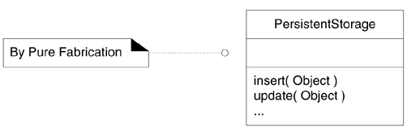
Pure Fabrication:Example-3
Notes:
合理的方案是创建一个新类
使其独自在某种持久性储存介质中保存对象
对该类命名为 PersistentStorage
该类是纯虚构的臆想之物
注意其名称：PersistentStorage
虽然这个概念是可以被理解的
但是我们却无法在领域模型中
找到这个名称或“持久性存储”的概念
并且如果开发者询问商店里的业务人员
“你使用持久性存储对象吗”，他们不会理解
他们能够理解诸如“销售”和“文件”的概念
而 PersistentStorage 并不是领域概念
它只是为了便于软件开发而凭空捏造或虚构的概念

Slide 13
Pure Fabrication:Example-4
This Pure Fabrication solves the following design problems:
The Sale remains well-designed, with high cohesion and low coupling.
The PersistentStorage class is itself relatively cohesive, having the sole purpose of storing or inserting objects in a persistent storage medium.
The PersistentStorage class is a very generic and reusable object.
Creating a pure fabrication in this example is exactly the situation in which their use is called for eliminating a bad design based on Expert, with poor cohesion and coupling, with a good design in which there is greater potential for reuse.
Notes:
1.纯虚构解决了如下设计问题
1.1 使 Sale 保持高内聚和低耦合的良好设计
1.2 PersistentStorage 类本身是相对内聚的
具有唯一目标，即在持久性存储介质中存储或插入对象
1.3 PersistentStorage 类是十分普遍和可复用的对象
2.在本例中，创建纯虚构正是由环境所驱使的
消除了基于专家模式的不良设计
改善了内聚和耦合，增加了潜在的复用性

Slide 14
Pure Fabrication: Discussion
The design of objects can be broadly divided into two groups:
Those chosen by representational decomposition.
Those chosen by behavioral decomposition.
A Pure Fabrication is usually partitioned based on related functionality, so it is a kind of function-centric or behavioral object.
Notes:
1.通常，此类的设计可以被广泛地分为两组
1.1 通过表示解析（representational decomposition）所产生的选择
1.2 通过行为解析（behavioral decomposition）所产生的选择
2.纯虚构通常基于相关功能性进行划分
因此这是一种以功能为中心的或行为的对象

Slide 15
Pure Fabrication: Others
Contraindications
If overused, Pure Fabrication could lead to too many behavior objects that have responsibilities not co-located with the information required for their fulfillment, which can adversely affect coupling.
Benefits
High Cohesion is supported because responsibilities are factored into a fine-grained class that only focuses on a very specific set of related tasks.
Reuse potential may increase because of the presence of fine-grained Pure Fabrication classes whose responsibilities have applicability in other applications.
Related Patterns and Principles
Low Coupling and High Cohesion.
Adapter, Command and Strategy
Notes:
1.禁忌
如果滥用虚构，会导致大量行为对象
其职责与执行职责所需的信息没有结合起来
这样会对耦合产生不良影响
2.优点
2.1 支持高内聚，因为职责被解析为细粒度的类
这种类只着重于极为特定的一组相关任务
2.2 增加了潜在的复用性
因为细粒度纯虚构类的职责可适用于其他应用
3.类似模式和原则
3.1低耦合和高内聚
3.2适配器、命令和策略模式
//防止变异
//适配器、命令、组合、代理、状态和策略模式

Slide 16
Content Outline
Polymorphism.
Pure Fabrication.
Indirection.
Protected Variations
Notes:
下面介绍
间接性
// 后面仅供参考，不放入脚本
下面介绍
纯虚构
下面介绍
间接性
最后介绍
防止变异

Slide 17
Indirection
Problem
Where to assign a responsibility, to avoid direct coupling between two (or more) things?
How to de-couple objects so that low coupling is supported and reuse potential remains higher?
Solution
Assign the responsibility to an intermediate object to mediate between other components or services so that they are not directly coupled.
The intermediary creates an indirection between the other components.
Notes:
问题
1两个或多个事物之间直接耦合应该如何分配职责？
2如何使对象解耦合，以支持低耦合并提高复用性潜力？
解决方案
1将职责分配给中介对象
使其作为其他构件或服务之间的媒介
以避免它们之间的直接耦合
2中介实现了其他构件之间的间接性(indirection)

Slide 18
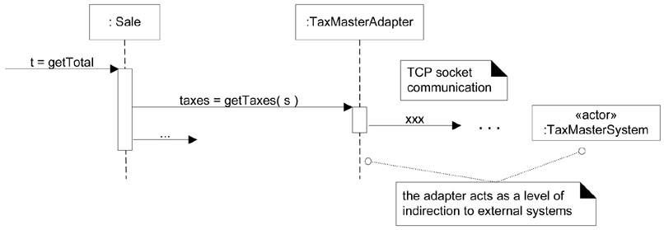
Indirection:Example
TaxCalculatorAdapter
Figure 25.10. Indirection via the adapter.
Notes:
这些对象对于外部税金计算器来说充当了中介的角色
通过多态，它们为内部对象提供了一致的接口
并且隐藏了外部 API 的变化
通过增加一层中间性和多态性
适配器对象保护了内部设计
使其不受接口变化的影响（见图 25.10）
注意
在图 25.10 中是如何对外部 TaxMaster 远程服务应用建模的
使用 《actor》关键字作为标识
用以指出这对我们的 NextGen 系统来说是外部软件构件

Slide 19
Indirection: Discussion
"Most problems in computer science can be solved by another level of indirection" is an old adage with particular relevance to object-oriented designs.
Just as many existing design patterns are specializations of Pure Fabrication, many are also specializations of Indirection. Adapter, Facade, and Observer are examples [GHJV95].
In addition, many Pure Fabrications are generated because of Indirection. The motivation for Indirection is usually Low Coupling; an intermediary is added to decouple other components or services.
Notes:
1.“计算机科学中的大多数问题都可以通过增加一层间接性来解决”
这一格言特别适用于面向对象设计
2.如同大量现有的设计模式是纯虚构的特例一样
许多设计模式也同样是间接性的特例
适配器（Adapter）、外观（Facede）和观察者（Obsever）
就是这样的例子[GHJV95]
3.此外，许多纯虚构是因为间接性而产生的
间接性的动机
通常是为了低耦合，即在其他构件或服务之间加入中介以解耦

Slide 20
Indirection: Others
Benefits
Lower coupling between components.
Related Patterns and Principles
Protected Variations
Low Coupling
Many GoF patterns, such as Adapter, Bridge, Facade, Observer, and Mediator [GHJV95].
Many Indirection intermediaries are Pure Fabrications.
Notes:
1.优点
实现了构件之间的低耦合
2.相关模式和原则
2.1 防止变异
2.2 低耦合
2.3 大量GoF模式，诸如
适配器（Adapter）、桥（Bridge）
外观（Facade）、观察者（Obesever）
中介（Mediator）
2.4大量间接性中介都是纯虚构

Slide 21
Content Outline
Polymorphism.
Pure Fabrication.
Indirection.
Protected Variations
Notes:
最后介绍
防止变异
// 后面仅供参考，不放入脚本
下面介绍
纯虚构
下面介绍
间接性
最后介绍
防止变异

Slide 22
Protected Variations
Problem
How to design objects, subsystems, and systems so that the variations or instability in these elements does not have an undesirable impact on other elements?
Solution
Identify points of predicted variation or instability;
Assign responsibilities to create a stable interface around them.
Notes:
1.问题
如何设计对象、子系统和系统
使其内部的变化或不稳定性
不会对其他元素产生不良影响？
2.解决方案
2.1.识别预计变化或不稳定之处
2.2.分配职责用以在这些变化之外创建稳定接口

Slide 23
Protected Variations: Discussion
This is a very important, fundamental principle of software design!
Almost every software or architectural design trick in book data encapsulation, polymorphism, data-driven designs, interfaces, virtual machines, configuration files, operating systems, and much more is a specialization of Protected Variations.
Notes:
1.这是非常重要和基本的软件设计原则！
2.本书中几乎所有的软件或架构设计技巧
都是防止变异的特例
例如，数据封装、多态、数据驱动设计
接口、虚拟机、配置文件和操作系统等

Slide 24
Protected Variations: Discussion
Mechanisms Motivated by Protected Variations
PV is a root principle motivating most of the mechanisms and patterns in programming and design to provide flexibility and protection from variations in data, behavior, hardware, software components, operating systems, and more.
Data encapsulation, interfaces, polymorphism, indirection, and standards are motivated by PV. Note that components such as virtual machines and operating systems are complex examples of indirection to achieve PV.
Notes:
源于防止变异的核心机制
1 PV是一个根本原则，其促成了大部分编程和设计的机制和模式
用来提供灵活性
和防止变异，包括
数据、行为、硬件、软件构件和操作系统等方面的变异
2 数据封装、接口、多态、间接性和标准都是源于PV的
注意：诸如虚拟机和操作系统等构件是实现PV的间接性的复杂例子

Slide 25
Protected Variations :Example-1
For example, the prior external tax calculator problem and its solution with Polymorphism illustrate Protected Variations (Figure 25.1). The point of instability or variation is the different interfaces or APIs of external tax calculators. The POS system needs to be able to integrate with many existing tax calculator systems, and also with future third-party calculators not yet in existence.
By adding a level of indirection, an interface, and using polymorphism with various ITaxCalculatorAdapter implementations, protection within the system from variations in external APIs is achieved. Internal objects collaborate with a stable interface; the various adapter implementations hide the variations to the external systems.
Notes:
1.例如，前述的外部税金计算器问题
及其使用多态的解决方案
能够描述防止变异（见图25.1）
其中的不稳定或变化之处是
外部税金计算器所具有的不同接口或 API
POS 系统需要能与大量现有税金计算器系统进行集成
并且还能与现在还不存在
但将来可能出现的第三方计算器进行集成
2.通过增加一层间接性，即接口
并且使用具有不同 ITaxCalculatorAdapter 实现的多态性
这样便实现了对内部系统的保护
而避免了外部 API 的变化所产生的影响
内部对象只与稳定的接口协作
各种适配器实现隐藏了外部系统的变化

Slide 26
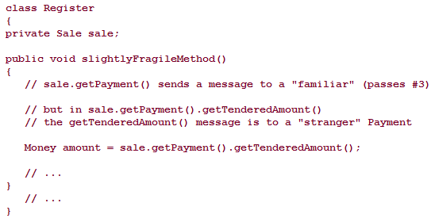

Protected Variations : Example-2
Here is an example that (mildly) violates Don't Talk to Strangers. The comments explain the violation.
Notes:
防止变异：例子 2
这是一个例子
在一定程度上 违反了“不要和陌生人讲话”的原则
其中的注释解释了其中的违例
在该代码中，从熟人对象 Sale 到陌生人 Payment 对象建立了连接
然后又向后者发送了消息
这种设计十分脆弱
因为他依赖于实际 Sale 对象与 Payment 对象之间的连接
如情况 1 和情况 2 所示
严格遵循“不要和陌生人讲话”的原则
需要对“熟人”对象增加新的公共操作
这些操作提供了最终所需的消息
并且隐藏了信息获取的细节

Slide 27
Protected Variations : Discussion
The design of objects can be broadly divided into two groups:
Those chosen by representational decomposition.
Those chosen by behavioral decomposition.
A Pure Fabrication is usually partitioned based on related functionality, so it is a kind of function-centric or behavioral object.
Notes:
1.此类的设计可以被广泛地分为两组
1.1通过表示解析（representational decomposition）所产生的选择
1.2通过行为解析（behavioral decomposition）所产生的选择
2.纯虚构通常基于相关功能性进行划分
因此这是一种以功能为中心的或行为的对象

Slide 28
Protected Variations : Others
Contraindications
Novice developers tend toward brittle designs, intermediate developers tend toward overly fancy and flexible, generalized ones (in ways that never get used). Expert designers choose with insight; perhaps a simple and brittle design whose cost of change is balanced against its likelihood.
Benefits
Extensions required for new variations are easy to add.
New implementations can be introduced without affecting clients.
Coupling is lowered.
The impact or cost of changes can be lowered.
Notes:
1.禁忌
初学者倾向于脆弱的设计
而中等程度的开发者则倾向于过渡想象的、灵活的、一般化的设计
专家级的开发者会理智地进行选择
有时简单、脆弱的设计可能会与其变化所需的成本达成平衡
2.优点
2.1易于增加新变化所需的扩展
2.2可以引入新的实现而无需影响客户
2.3降低耦合
2.4能够降低变化的成本或影响
//
防止变异
适配器、命令、组合、代理、状态和策略模式
别称和类似模式
选择消息，不要询问“什么类型”

Slide 29
Protected Variations : Others
Related Patterns and Principles
Most design principles and patterns are mechanisms for protected variation, including polymorphism, interfaces, indirection, data encapsulation, most of the GoF design patterns, and so on.
Also Known As; Similar To
PV is essentially the same as the information hiding and open-closed principles, which are older terms.
Notes:
1.相关模式和原则
大部分设计原则和模式都是防止变异的机制
这包括多态、接口、间接性、数据封装和大部分 GoF 设计模式等
2.别称和类似模式
PV 基本上等同于信息隐藏和开放封闭原则

Slide 30
Review : GRASP: More Objects with Responsibilities
How to apply the four GRASP patterns
Polymorphism
Indirection
Pure Fabrication
Protected Variations
Notes:
下面请大家 回顾一下本次课的知识内容
如何应用下面 4 个GRASP设计模式？
多态
间接性
纯虚构
防止变异

Slide 31
Special Topics
What is Liskov Substitution Principle?
What is Information Hiding?
What is OCP Principle?
Notes:
最后，作为扩展知识域的学习，
请大家课后回答
1.什么是 Liskov 替换原则？
2.什么是信息隐藏？
3.什么是开放-封闭原则？

